Slide 1
Inexpensive gaming
Team: Josh Lenhart, Josh Timmers
Advisor: Jillian Aurisano

Slide 2
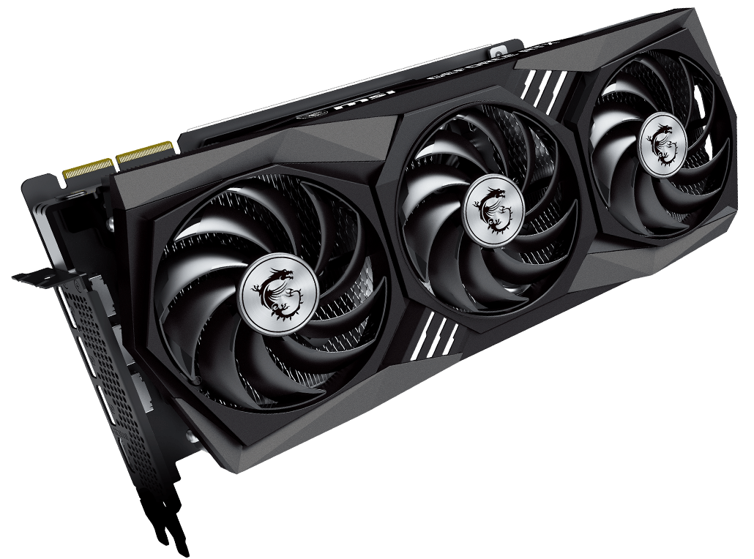
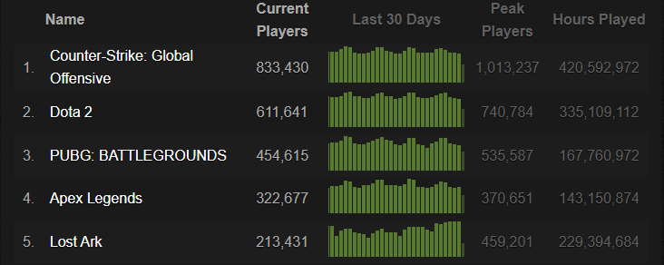
Goals
Design a user-friendly website that can easily show the best price of different parts along with whether they meet the recommended or minimum requirements for some of the current top games.

Slide 3
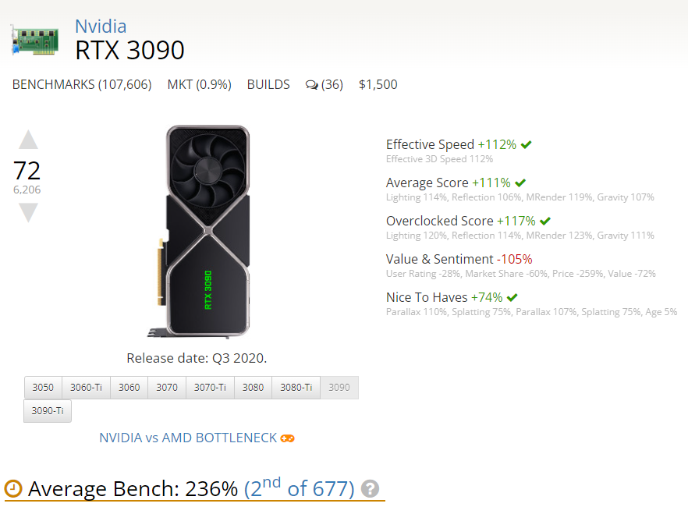
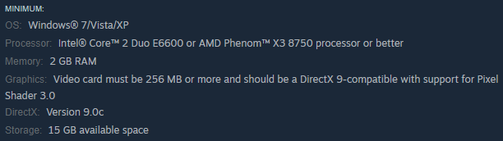
Merits
With our project, we wanted to add onto the classic model of just displaying prices. To do this, we added whether the parts would meet the minimum requirements for different games as well as their associated benchmark.

Slide 4
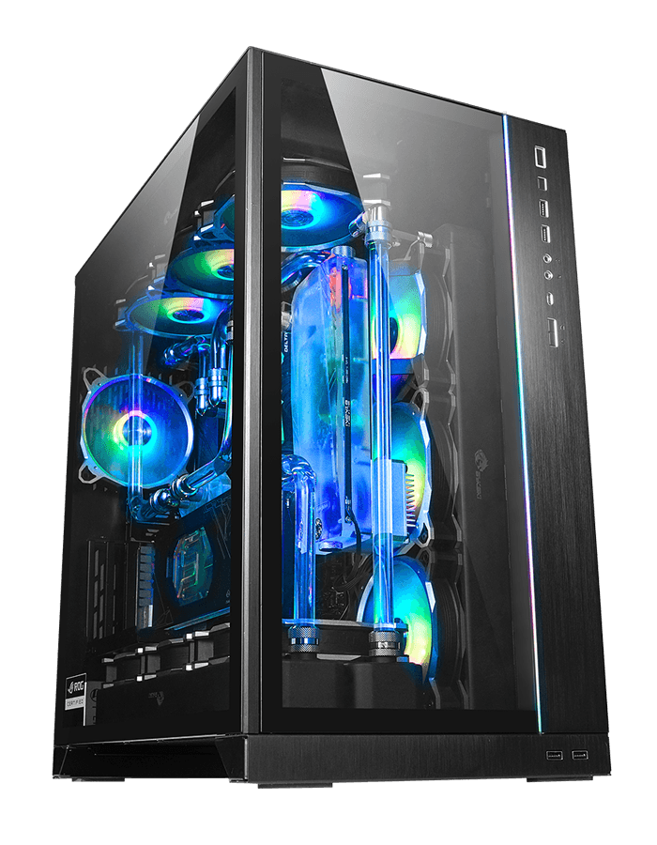
Impacts
Gaming has become one of the biggest hobbies enjoyed by people worldwide. While consoles are simple ways to get into gaming in an affordable manner, not all gaming experiences can be had without a PC. The issue with this is that not everyone knows how to build PCs or how well the parts will perform. Along with this some sites do not have the same price. With our website, the user will not have to worry about these issues.

Slide 5
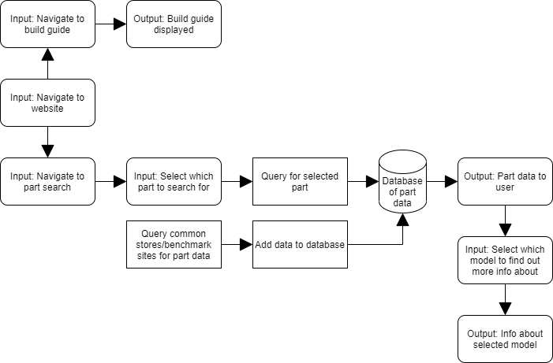
Design Specification

Slide 6



Technologies
For our backend we are using Python. We use the modules BeautifulSoup4 and requests to do the web scraping. We then use MongoClient to push the scraped data to the MongoDB database in the cloud. For our website we used the NextJS framework along with the MongoDB API to connect to the database.

Slide 7
Milestones
Develop script to farm data: 1/01/2022
Begin showing parts on webpage: 2/01/2022
Show requirements data: 3/01/2022
Show benchmark data: 4/01/2022

Slide 8
Results
Our website allows the user to look through lists of different types of parts. Each part shows the prices for Microcenter and Newegg, the minimum requirements it meets, and its approximate benchmark. Along with this, we have a page with a simple build guide along with links to more in depth videos. We also have a page where the user can see the top 5 highest benchmarks for different parts.

Slide 9
Challenges
Our first challenge was to figure out how to deal with scraping pages that are sometimes laid out for the same types of parts. After this we faced numerous challenges with displaying the data on the website. We have had to make the website slightly less user-friendly due to this. Along with this we faced issues with matching the parts for the requirements and benchmark data, so this is currently being done by hand.

